Slide 1
Topics
SQL procedures review
PL/SQL Conditional Statements
Midterm Review

Slide 2
Review
What is server side application logic?
What program units are stored with the database server
Procedures, functions, packages, triggers
What is the difference between a procedure and a function

Slide 3
SQL PROCEDURES
To run a procedure called PROC1 in DB2 type
CALL PROC1
SQL/PL
In ORACLE type
EXECUTE PROC1
PL/SQL
DIFFERENT TYPES OF ARGUMENTS FOR A PROCEDURE ARE
IN OUT IN OUT

Slide 4
PL/SQL Conditional Statements
IF statement
IF THEN
IF THEN ELSE
IF THEN ELSIF ELSE
CASE
Compare a given expression to different values
Evaluates multiple conditions and choose the first condition that is true

Slide 5
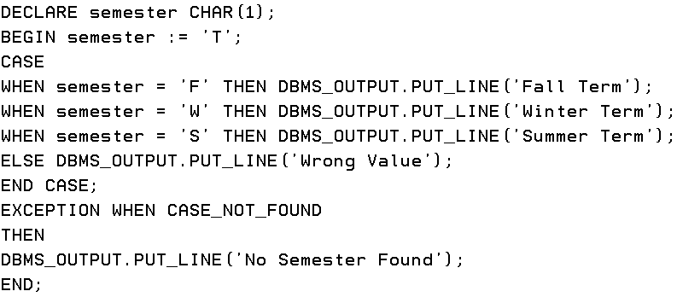
Case
What is an alternative version of Case with slightly different syntax for this problem

Slide 6
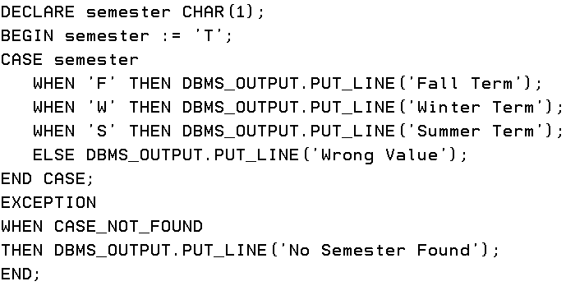
Alternative Case Syntax

Slide 7
What are the three possible blocks in a procedure?
Declarative, Executable, Exception
What is an anonymous block
Not saved as a stored procedure on server, no name required, used for testing a stored procedure’s arguments
Where can an anonymous block be saved?
As a file on your Desktop or Laptop

Slide 8
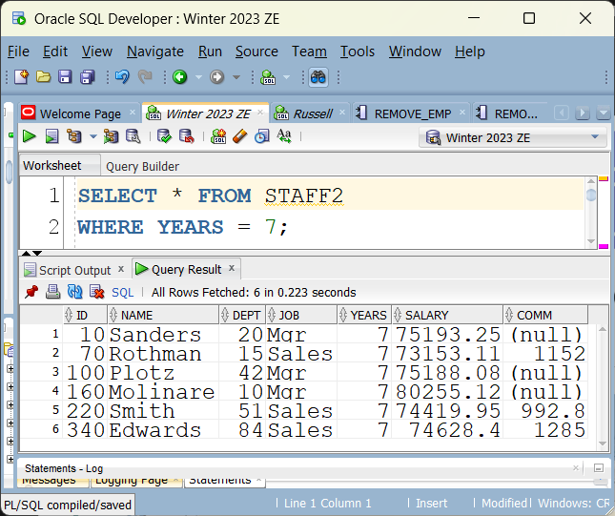
RemoveEmployees Stored Procedure
Some staff employees have 7 years of post secondary education

Slide 9
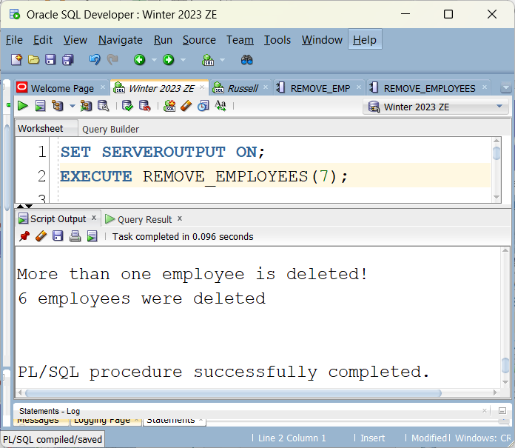
RemoveEmployees Stored Procedure

Slide 10
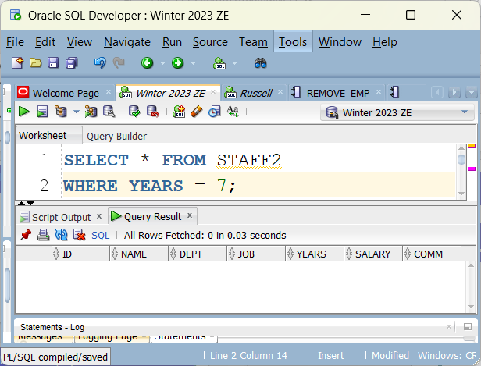
RemoveEmployees Stored Procedure
After the procedure is run

Slide 11
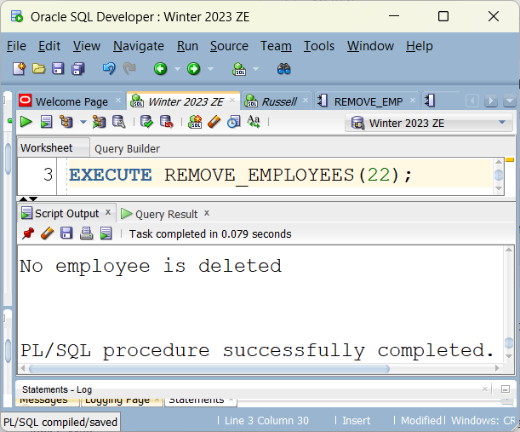
RemoveEmployees Stored Procedure
No employee has 22 years of post secondary education

Slide 12
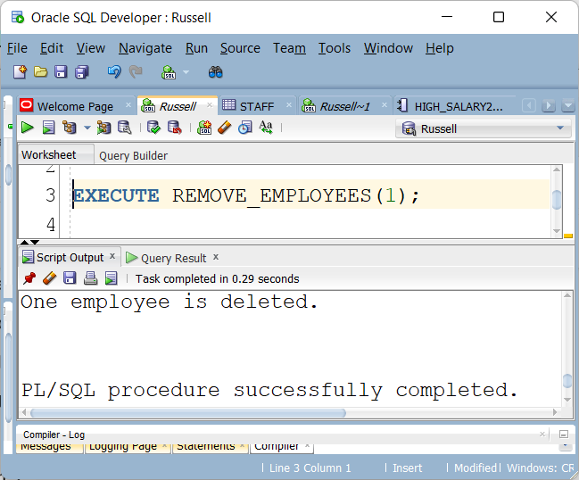
RemoveEmployees Stored Procedure

Slide 13
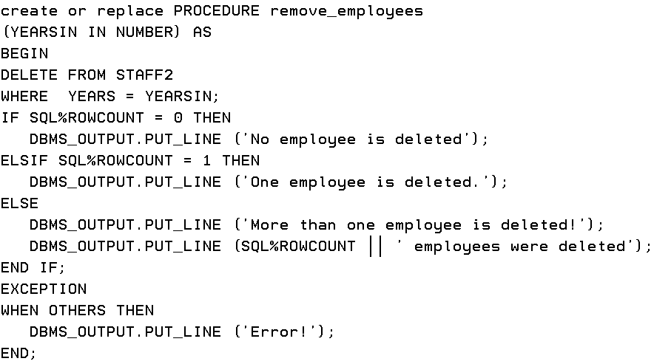
RemoveEmployees (SQL%RowCount)
Using ELSIF and SQL%RowCount

Slide 14
Can we get all those deleted employees back?
ROLLBACK;

Slide 15
Midterm Review
How is not equal shown in an expression
<>
!=

Slide 16
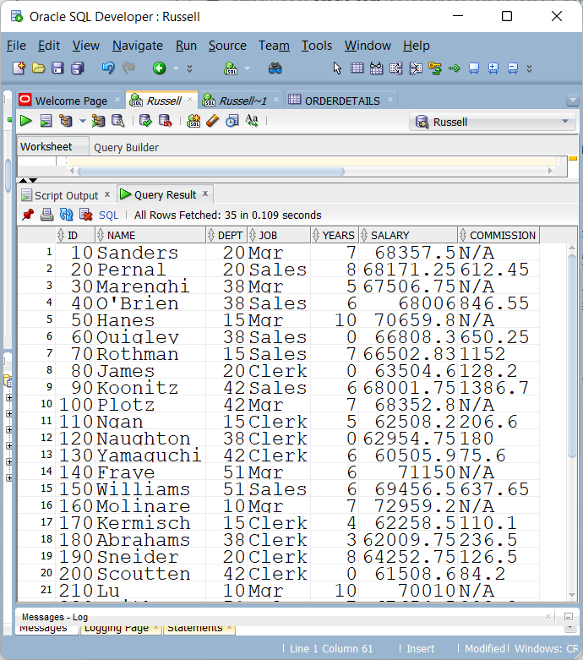
Null commission shows N/A

Slide 17
Null commission shows N/A
SELECT
NAME, DEPT,JOB,YEARS,SALARY,
COMM? (a number column)
nvl(to_char(comm), 'N/A')commission
FROM STAFF

Slide 18
What is the difference between single row and multi row functions
Single row function returns one result for each row
What is another name for a single row function
A Scaler Function
Multi row returns one result per set of rows
What is another name for a multi row function
An Aggregate Function

Slide 19
SINGLE ROW FUNCTION TYPES?
CHARACTER
NUMERIC
DATETIME
CONVERSION

Slide 20
Convert Days to Weeks & Days
With DAYS set to 20
There are 2.85714285714285714285714285714285714286 weeks
and 6 days
DECLARE
DAYS NUMBER(7) := 20;
BEGIN
DBMS_OUTPUT.PUT_LINE ('With DAYS set to ' || DAYS);
DBMS_OUTPUT.PUT_LINE ('There are ' || DAYS/7 || ' weeks');
DBMS_OUTPUT.PUT_LINE ('and ' || Mod(DAYS,7) || ' days');
END;

Slide 21
Change 2.85714285714285714285714285714285714286 weeks
To 2 weeks
DBMS_OUTPUT.PUT_LINE
('There are ' || trunc(DAYS/7,0) || ' weeks’);
Name five multi row functions
AVG, COUNT, SUM, MIN, MAX
DO AGGREGATE FUNCTIONS INCLUDE NULL VALUES?
100 PEOPLE WITH NON NULL SALARIES
10 PEOPLE WITH NULL SALARIES
DOES AVG FUNCTION USED WITH SALARY DIVIDE BY 100 OR 11O?

Slide 22
Average MSRP for products
100.297090909090909090909090909090909091
round(avg(msrp),2)
IF YOU GET 100.3000000000000000
select
cast(round(avg(msrp),2) as number(7,2))
from products;

Slide 23
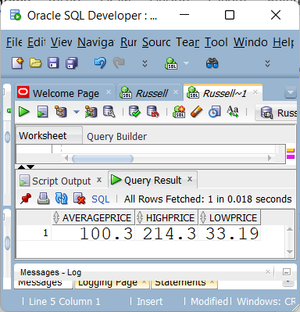
MSRP in PRODUCTS TABLE
select cast(round(avg(msrp),2) as number(7,2)) averageprice,
max(msrp) highprice,
min(msrp) lowprice
from products;

Slide 24
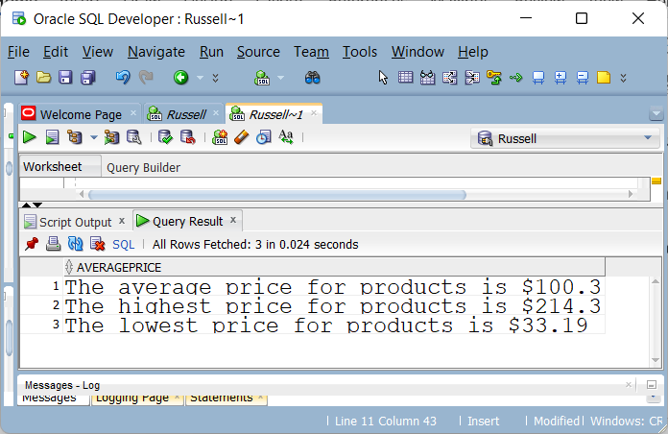
Using a single statement produce the following

Slide 25
Produce the following

Slide 26
select 'The average price for products is $' ||
cast(round(avg(msrp),2) as number(7,2)) averageprice
from products
union all
select 'The highest price for products is $' ||
max(msrp) highprice
from products
union all
select 'The lowest price for products is $' ||
min(msrp) lowprice
from products;

Slide 27
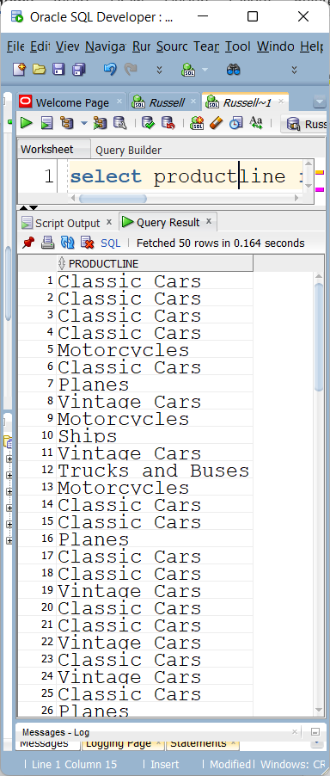
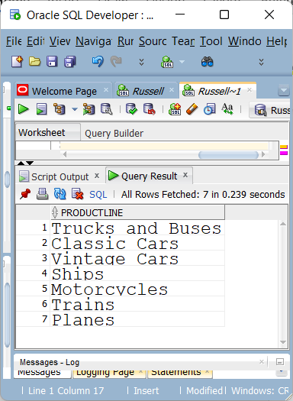
PRODUCTLINE IN PRODUCTS

Slide 28
SELECT PRODUCTLINE
FROM PRODUCTS
BECOMES
SELECT DISTINCT PRODUCTLINE
FROM PRODUCTS

Slide 29
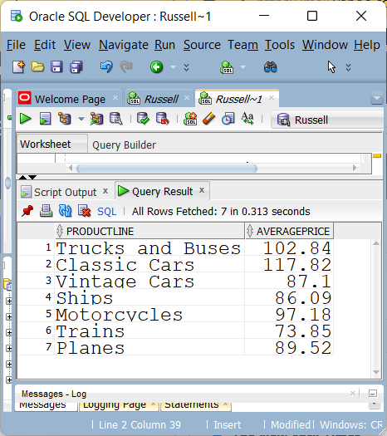
Average MSRP

Slide 30
select productline,
round(avg(msrp),2) averageprice
from products
group by productline;
we consider expensive product lines – only if the average price is over 100

Slide 31
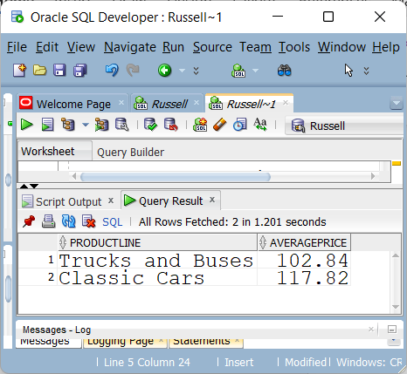
select productline,
round(avg(msrp),2) averageprice
from products
group by productline
having avg(msrp) > 100

Slide 32
Can that be replaced by
select productline,
round(avg(msrp),2) averageprice
from products
where avg(msrp) > 100
group by productline;
No, the group function is not allowed in the where clause

Slide 33
Where vs Having
What is the difference between a where clause and a having clause?
The where clause filters out rows that don’t meet a search condition
The having clause filters out entire groups that don’t meet a search condition

Slide 34
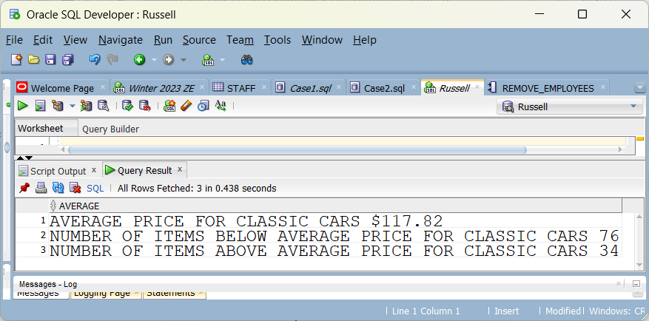
ProductLine and MSRP

Slide 35
select 'Average price for Classic Cars $' ||
round(avg(msrp),2) Average
from products where productline = ‘Classic Cars’
union all
select 'Number of Items below average price for Classic Cars ' ||
count(*) belowavgprice
From products where msrp <
(select avg(msrp)
from products
where productline = 'Classic Cars')
union all
select 'Number of Items above average price for Classic Cars ' ||
count(*) belowavgprice
From products where msrp >
(select avg(msrp)
from products
where productline = 'Classic Cars')

Slide 36
Subqueries
Where can you use a subquery?
SELECT
CREATE
INSERT
DELETE
IN A SELECT
WHERE CLAUSE
HAVING CLAUSE
FROM CLAUSE

Slide 37
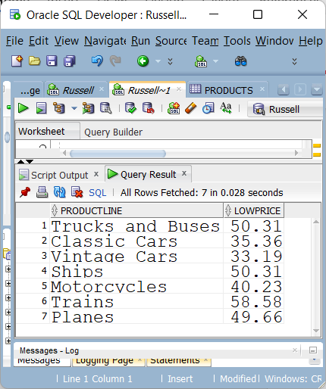
The Lowest Price for Each Productline

Slide 38
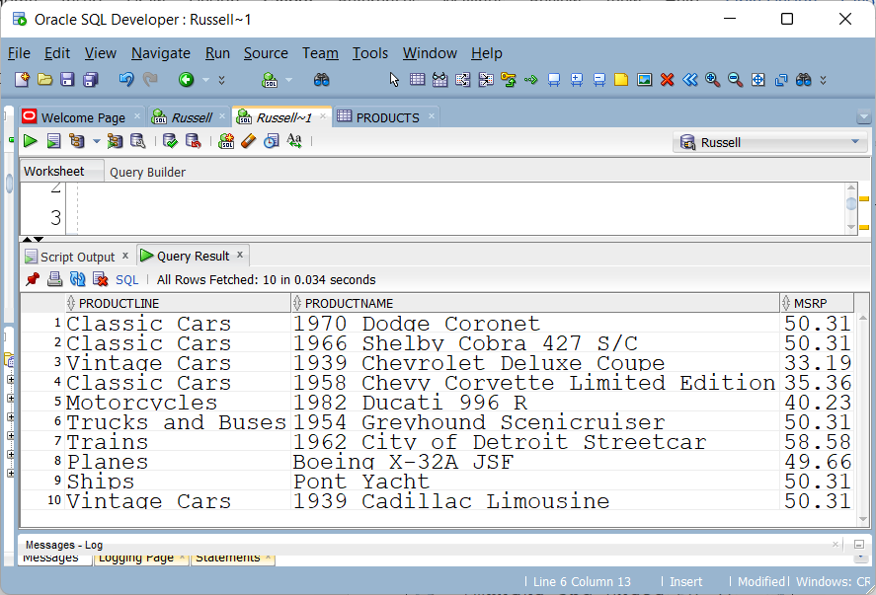
List the prodcuts that match any of the lowest price for any productline

Slide 39
Answer
select productline, productname,msrp
from products
where msrp in
(select min(msrp) from products
group by productline);

Slide 40
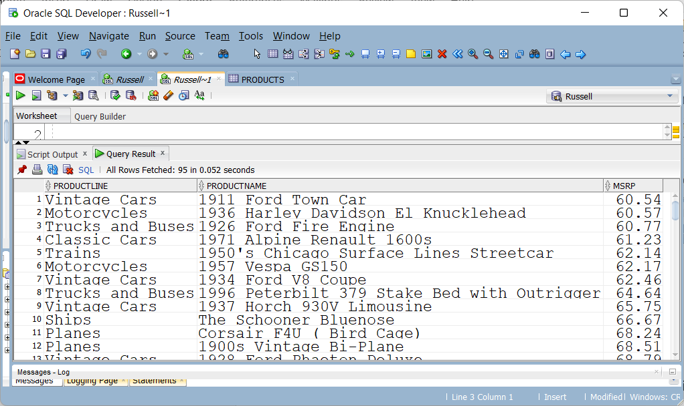
Show the products that cost more than the maximum of the minimum prices

Slide 41
Answer
select productline,
productname,
msrp
from products
where msrp > all
(select min(msrp)
from products
group by productline);

Slide 42
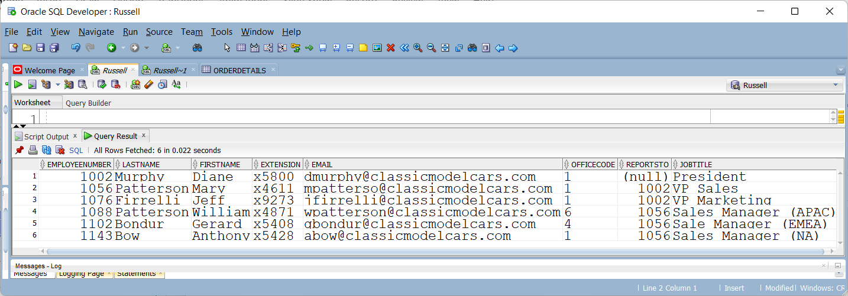
MANAGEMENT Table

Slide 43
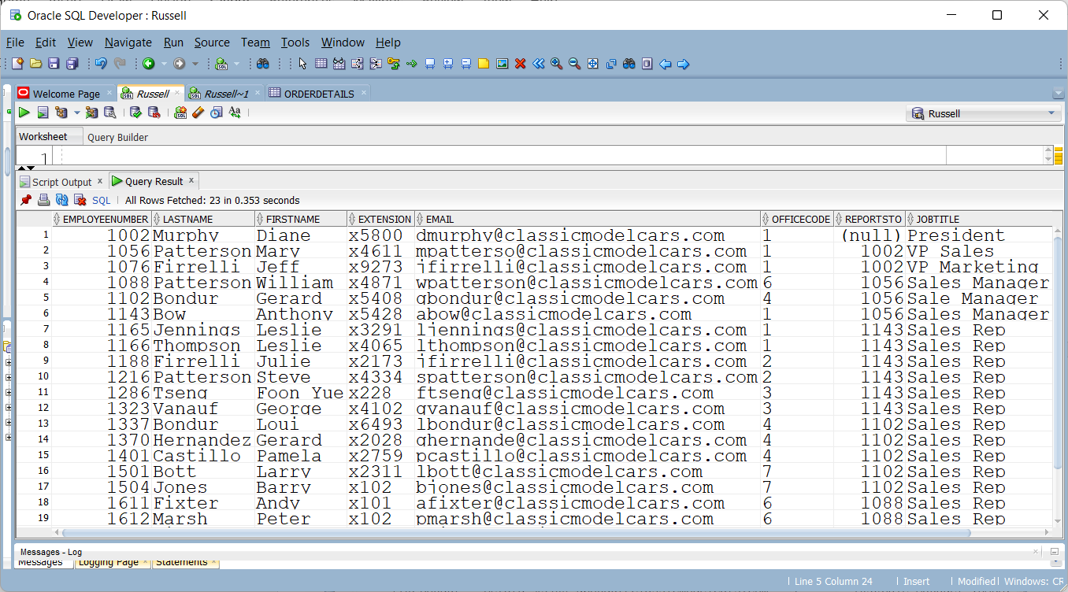
EMPLOYEES Table

Slide 44
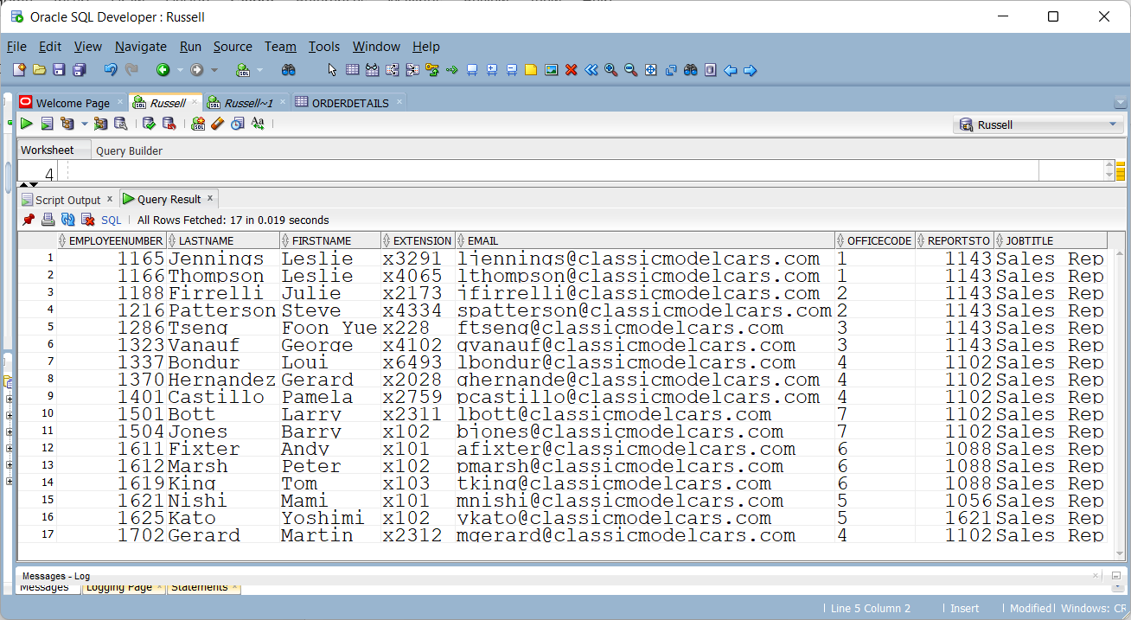
Include both tables and produce this
Show all the rows in the employees table not found in the management table

Slide 45
Answer
select * from employees
minus
select * from management;
DB2 uses EXCEPT
Can this be done if management had one extra column called BONUS and employees did not have that extra column?
Yes – just list the matching fields
No asterisk for all the columns with Management
Can use an asterisk with EMPLOYEE as long as the Management column list matches the expected order of columns in EMPLOYEE

Slide 46
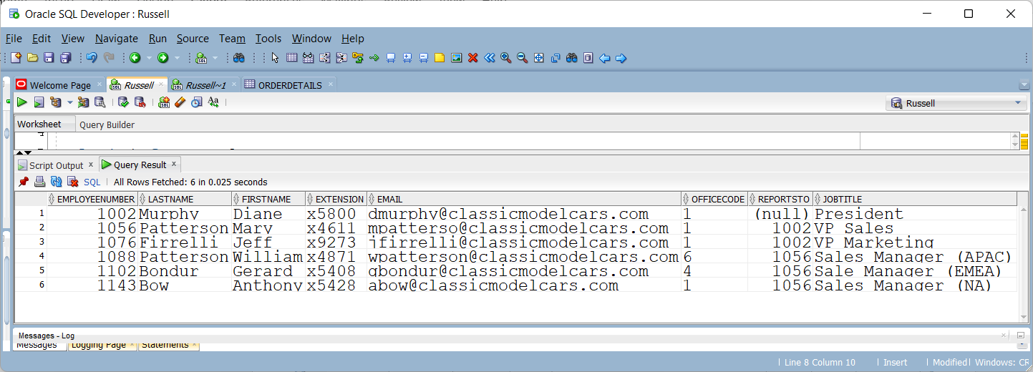
Include both tables and produce this
Show the identical rows found in the EMPLOYEES and MANAGEMENT tables
select * from employees
intersect
select * from management;

Slide 47
Lab 5
Lab 5 has been posted as an Oracle lab

